Slide 1


Personal Travel Assistant(PTA)
FastAPI + MongoDB Backend Project

Slide 2

Personal Travel Assistant(PTA)
FastAPI + MongoDB Backend Project

Slide 3


Introduction
The Personal Travel Assistant (PTA) is a smart backend application designed to streamline the process of planning and booking trips. Built using FastAPI for high-performance APIs and MongoDB for scalable data storage, it provides travelers with a single, unified platform to access critical travel information.
Instead of juggling multiple apps and websites, users can rely on PTA to:
🌦 Check real-time weather forecasts for their destination and receive smart suggestions such as “Carry an umbrella” or “Avoid travel due to heavy rains”.
🚌 Browse bus options from APSRTC, TSRTC, and private travel operators, complete with timings, seat types, and fares.
🏨 View available hotels at the destination, with ratings, pricing, and location details.
💼 Book both bus and hotel in one seamless request, ensuring convenience.
💾 Store and retrieve bookings in MongoDB, making it reliable and accessible anytime.
Personal Travel Assistant

Slide 4

By integrating external APIs (Open-Meteo, MakCorps) along with mocked bus data, PTA creates an end-to-end backend solution that is both scalable and client-ready. It not only simplifies trip planning for travelers but also demonstrates how modern backend systems can combine multiple services into one platform effectively.
Personal Travel Assistant

Slide 5

Objective
PTA solves these by:
Combining weather + buses + hotels.
Giving smart weather suggestions.
Single step booking.
Reliable MongoDB storage.
Personal Travel Assistant

Slide 6

Use Case
Plan trips with real-time weather + suggestions
Choose APSRTC, TSRTC, Private buses
Select hotels with ratings and price
Book bus & hotel in one step
Store bookings in MongoDB
Personal Travel Assistant

Slide 7
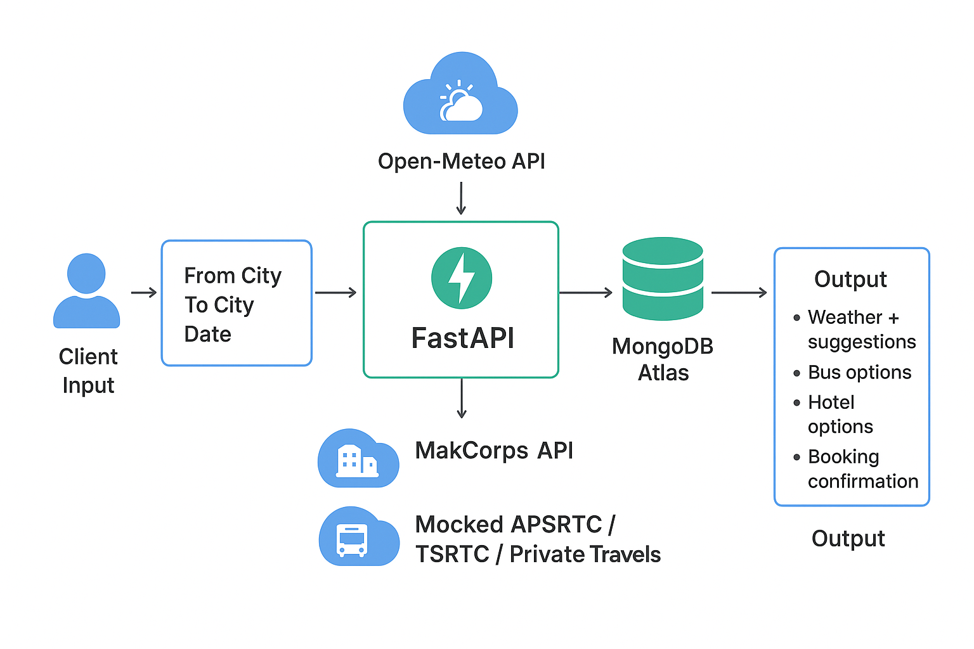
System Architecture
FastAPI backend
MongoDB Atlas
Open-Meteo API (Weather)
MakCorps API (Hotels)
Mock APSRTC/TSRTC/Private buses
Personal Travel Assistant

Slide 8






Workflow
01 - Search
02 - Book
03 – Get Bookings
User searches for a destination, triggering integrated requests for weather forecasts, available bus routes, and hotel options.
Seamless booking process where users confirm bus tickets and hotel reservations in one go.
Users can effortlessly retrieve and manage all their consolidated travel bookings from a single interface.
Personal Travel Assistant

Slide 9
API Endpoints
Method | Endpoint | Description
POST | /search | Search destination (weather, buses, hotels)
POST | /book | Book bus + hotel (saves to DB)
GET | /bookings | Retrieve all saved bookings
Personal Travel Assistant

Slide 10

Detailed Use Case 1
Real-time Weather:
Fetches from Open-Meteo API.
Example: Hyderabad → Vijayawada on 15 Sept shows 'Light Rain'.
Suggestion: Carry an umbrella 🌂.
Personal Travel Assistant

Slide 11
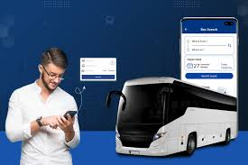
Detailed Use Case 2
Bus Search:
APSRTC, TSRTC, Private buses.
Shows operator, timings, price.
Example: APSRTC Volvo at 8 AM, ₹500.
Personal Travel Assistant

Slide 12

Detailed Use Case 3
Hotel Selection:
Uses MakCorps API.
Shows name, price, rating.
Example: Grand Vijayawada Hotel, ₹2500/night, rating 4.2⭐.
Personal Travel Assistant

Slide 13

Detailed Use Case 4
Unified Booking:
Select bus + hotel together.
Stores full details.
Saves time vs. multiple apps.
Personal Travel Assistant

Slide 14

Detailed Use Case 5
Bookings Storage:
MongoDB Atlas.
Reliable, scalable, secure.
Fetch all past bookings instantly.
Personal Travel Assistant

Slide 15

Workflow
Step 1
Search:
User enters From, To, Date.
System returns Weather + Buses + Hotels.
Smart suggestion provided.
Personal Travel Assistant

Slide 16

Workflow Step 2
Book:
User selects Bus ID + Hotel ID.
Booking saved in MongoDB.
Confirmation with booking_id.
Personal Travel Assistant

Slide 17

Workflow Step 3
Get Bookings:
User retrieves all saved trips.
Full bus + hotel details shown.
Example: Hyderabad to Vijayawada trip details.
Personal Travel Assistant

Slide 18


Sample Code: Search
Python (FastAPI):
@router.post('/search')
async def search_travel(req: SearchRequest):
weather = await get_weather_summary_for_city(req.to_city, req.depart_date)
buses = await search_buses(req.from_city, req.to_city, req.depart_date)
hotels = await search_hotels(req.to_city, limit=5)
return {...}
Personal Travel Assistant

Slide 19

Sample Code: Book
Python (FastAPI):
@router.post('/book')
async def create_booking(b: BookingRequest):
bus = await get_bus_by_id(b.bus_id, b.from_city, b.to_city, b.depart_date)
hotel = await get_hotel_by_id(b.hotel_id, b.to_city)
await bookings_collection.insert_one({...})
return BookingResponse(...)
Personal Travel Assistant

Slide 20

Database Schema
{
'user_name': 'John',
'email': 'john@example.com',
'from_city': 'Hyderabad',
'to_city': 'Vijayawada',
'depart_date': '2025-09-15',
'bus': {...},
'hotel': {...},
'booking_id': 'uuid',
'created_at': 'timestamp'
}
Personal Travel Assistant

Slide 21

Backend
Demonstration – Swagger UI
The backend is powered by FastAPI, with interactive API documentation provided by Swagger UI.
Through Swagger, we demonstrate how the PTA exposes endpoints for searching destinations (weather, buses, hotels), booking trips, and retrieving saved bookings. This ensures APIs are transparent, testable, and client-ready.
Note:
Video will be available at my local due to size Issue to push into Github.
Personal Travel Assistant

Slide 22
Frontend Demonstration – PTA User Experience
The frontend provides a simple and intuitive interface for end-users. Travelers can input their trip details, review weather forecasts, explore bus and hotel options, and complete their bookings in a few clicks.
This showcases how the backend APIs integrate seamlessly with the frontend, delivering a smooth travel planning experience.
Note:
Video will be available at my local due to size Issue to push into Github.
Personal Travel Assistant

Slide 23

Deployment Notes
Deployment Strategy:
Backend on AWS/Azure.
MongoDB Atlas for cloud DB.
Docker for portability.
CI/CD pipeline for updates.
Personal Travel Assistant

Slide 24

Scalability & Enhancements
Future Plans:
Add flights and trains.
Integrate payments (UPI, cards).
Add seat selection.
Mobile app frontend.
Personal Travel Assistant

Slide 25

Client Value Proposition
Why PTA is valuable:
Saves time for users.
Reliable & scalable.
Single platform for travel.
Ready for production.
Personal Travel Assistant

Slide 26

Conclusion
PTA is scalable and production-ready
Integrates weather, buses, hotels into one backend
Simplifies client travel planning
Personal Travel Assistant

Slide 27
Thank You

